Slide 1



Flight Booking System
Ishaan Agarwal (RA2211003010869)
Shreshtha Srivastava (RA2211003010872)

Slide 2


Abstract
The Airplane Booking System project, implemented in Python, revolutionizes the flight reservation process by providing an intuitive and efficient platform. This system empowers passengers to easily search for flights, select seats, and securely book their journeys. Leveraging Python's capabilities, the project integrates seamless payment processing and generates electronic tickets for confirmation.
For airline administrators, the system offers a robust dashboard to manage flight schedules, seat availability, and bookings. The system's data management ensures the security and integrity of passenger information through encryption and authentication protocols.
Automated email notifications keep passengers informed about booking details, enhancing communication and customer satisfaction. Through its user-friendly interfaces and comprehensive features, the Airplane Booking System project enriches the travel experience while providing airlines with an effective tool for streamlined management.

Slide 3
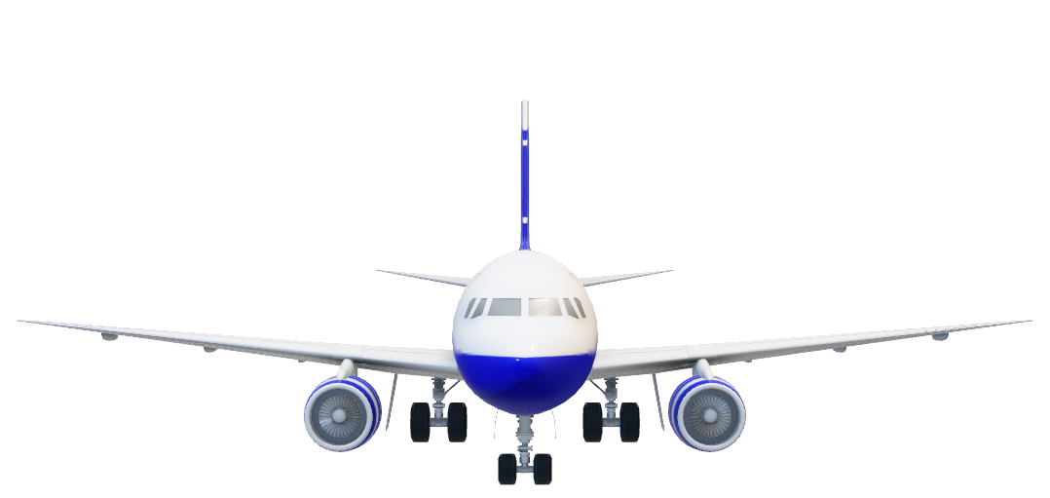
Introduction
This project has a database named 'JetAirways' containing tables 'flight' and 'passengers'. It was designed keeping in mind an airline connectivity. It is supposed to help the airports to generate bills and make changes accordingly. It is a very simple program and anyone without any kind of knowledge regarding programming can conveniently use it. The program allows user to add details, change details and to view the flight tickets. They can also cancel their tickets according to their convenience and all those changes can be easily incorporated in the database through this program.

Slide 4

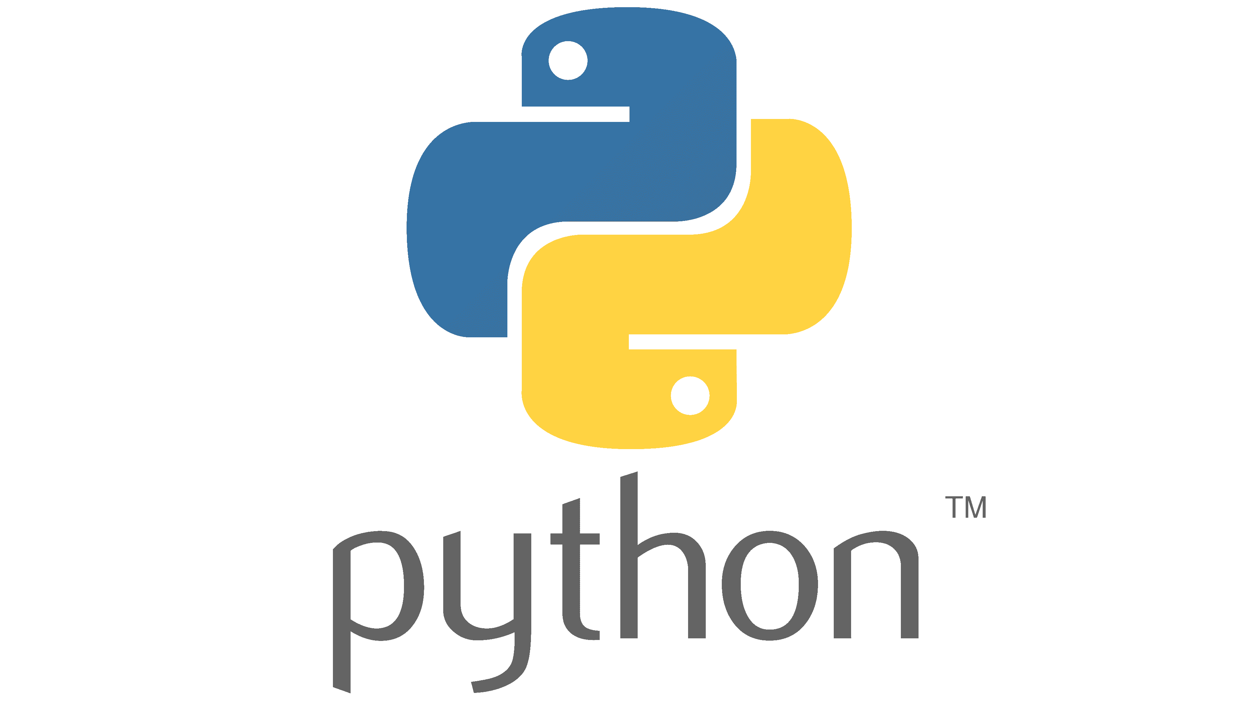
Tools Used
Python
Python is a high-level, general purpose programming language. Its design philosophy empathises code readability with the use of significant indentation.
Python is dynamically typed and garbage-collected. It supports multiple programming paradigms, including structured(particularly procedural), object-oriented and functional programming. It is often described as a "batteries included" language due to its comprehensive standard library.
Guido van Rossum began working on Python in the late 1980s as a successor to the ABC Programming Language and first released it in 1991 as Python 0.9.0. Python 2.0 was released in 2000. Python 3.0, released in 2008, was a major revision not completely backward-compatible with earlier versions. Python 2.7.18, released in 2020, was the last release of Python 2.
MySQL
MySQL is an open source relational database management system (RDBMS). Its name is a combination of "My", the name of co-founder Michael Widenious’s daughter My, and "SQL", the acronym for Structured Query Language. A relational database organizes data into one or more data tables in which data may be related to each other; these relations help structure the data. SQL is a language that programmers use to create, modify and extract data from the relational database, as well as control user access to the database. In addition to relational databases and SQL, an RDBMS like MySQL works with an operating system to implement a relational database in a computer's storage system, manages users, allows for network access and facilitates testing database integrity and creation of backups.

Slide 5
Objectives and Scope
The scope of a Flight Management System (FMS) implemented in Python could encompass a wide range of functionalities and components related to flight planning, navigation, and management. Here's a glimpse of the potential scope:
1. **Flight Planning and Routing:** - Route optimization considering factors like weather, air traffic, and fuel efficiency. - Generation of flight plans and waypoints. - Integration with aviation databases for navigation data.
2. **Navigation and Guidance:** - Real-time navigation, including flight path, headings, and altitudes. - Integration with GPS and other navigation systems. - Precision approach guidance for landing.
3. **Fuel Efficiency:** - Fuel consumption calculations and optimization. - Altitude and speed recommendations for fuel savings. - Monitoring and reporting of fuel usage during flight.
4. **Autopilot Integration:** - Communication and coordination with autopilot systems. - Automation of flight control tasks, such as maintaining headings and altitudes.
5. **Performance Monitoring:** - Monitoring and analysis of actual flight performance. - Comparison of actual performance with planned parameters.
6. **Flight Crew Support:** - Display of critical flight information to the flight crew. - Alerts and notifications for deviations or critical events. - User-friendly interface for flight crews to interact with the system.
7. **Terrain and Obstacle Avoidance:** - Terrain awareness and warning system (TAWS) integration. - Real-time obstacle detection and avoidance.

Slide 6
8. **Emergency and Contingency Planning:** - Support for emergency procedures and decision-making. - Contingency planning for unexpected events
9. **Data Recording and Analysis:** - Logging of flight data for post-flight analysis. - Generation of reports and summaries for flight review.
10. **Integration with External Systems:** - Integration with aircraft avionics and communication systems. - Interaction with external databases for weather information and airport details.
11. **User Management and Authentication:** - User accounts for flight crew and administrators. - Authentication and access control for different user roles.
12. **Error Handling and Diagnostics:** - Robust error handling and reporting mechanisms. - Diagnostics and troubleshooting features for technical issues.
13. **Security and Data Privacy:** - Implementation of data encryption and security measures. - Compliance with aviation industry standards for data privacy.
14. **User Interface (UI) Design:** - Development of a user-friendly and intuitive UI for flight crew interaction. - Visualization of flight data and navigation information.
The scope of a Flight Management System in Python can be tailored based on specific requirements, regulations, and the intended use within the aviation industry. It's important to collaborate with aviation experts and adhere to industry standards throughout the development process.

Slide 7
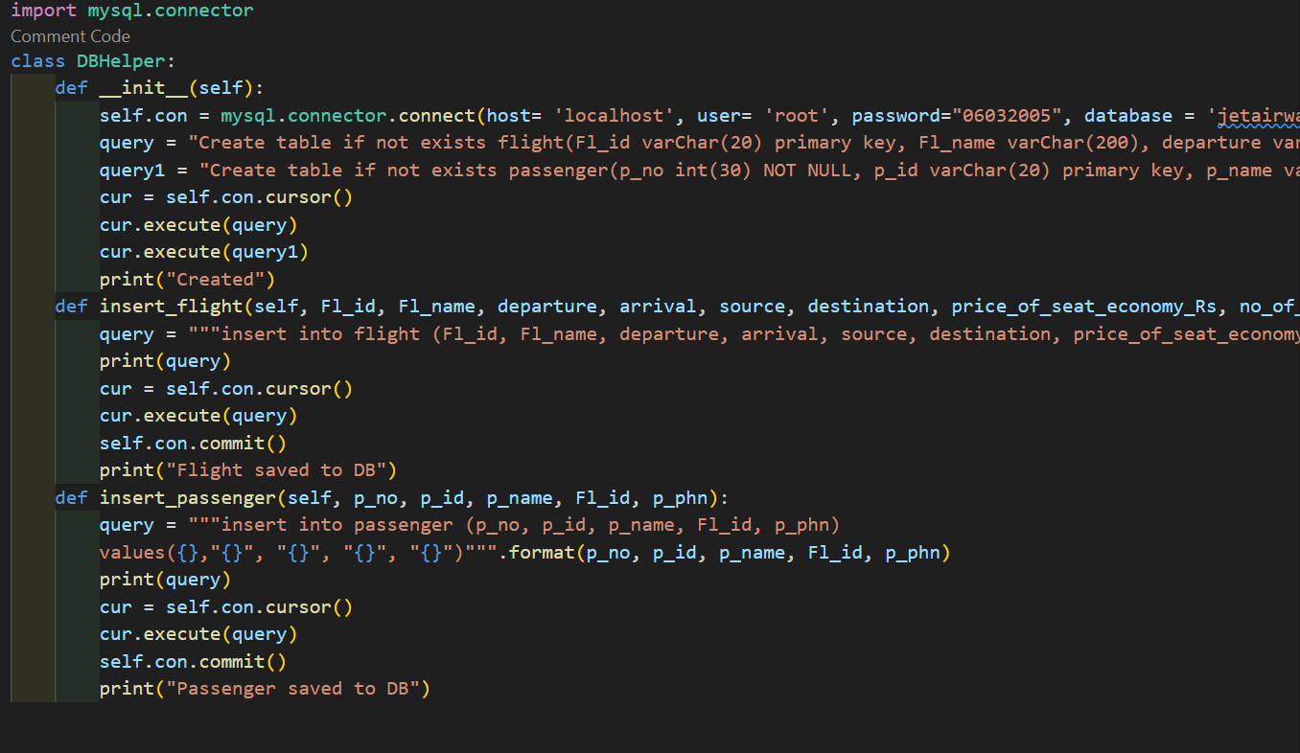
PYTHON CODE FOR CREATING TABLES AND INSERTING DATA:

Slide 8
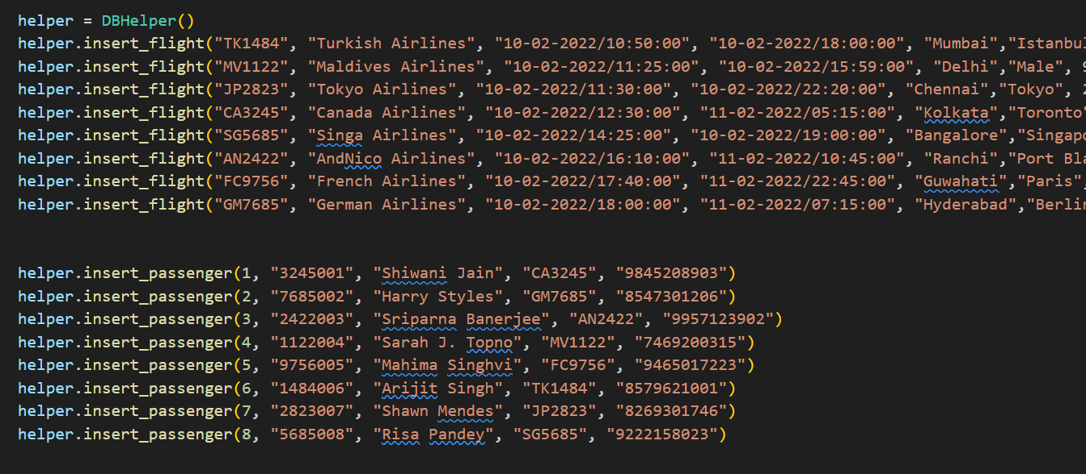

Slide 9
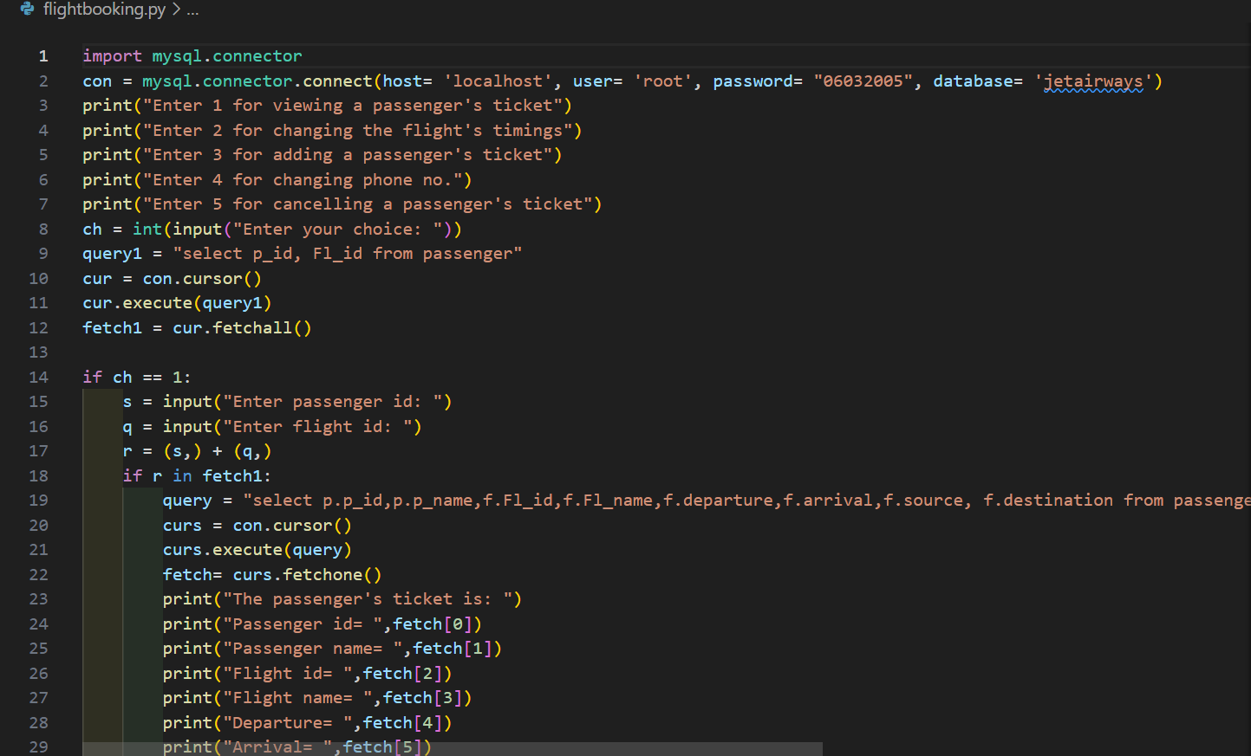
PYTHON CODE FOR PERFORMING VARIOUS FUNCTIONS:

Slide 10
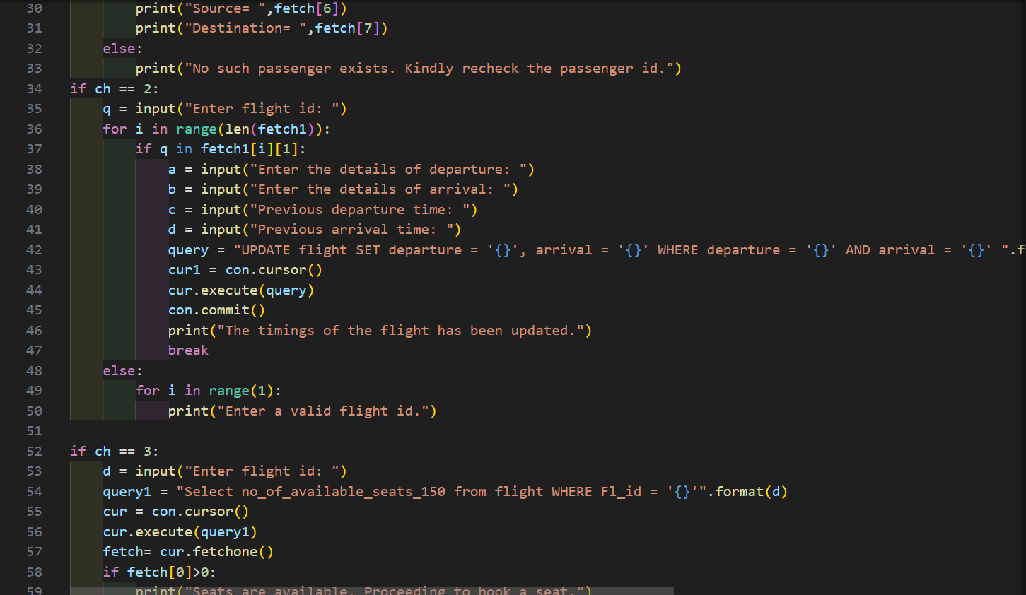

Slide 11
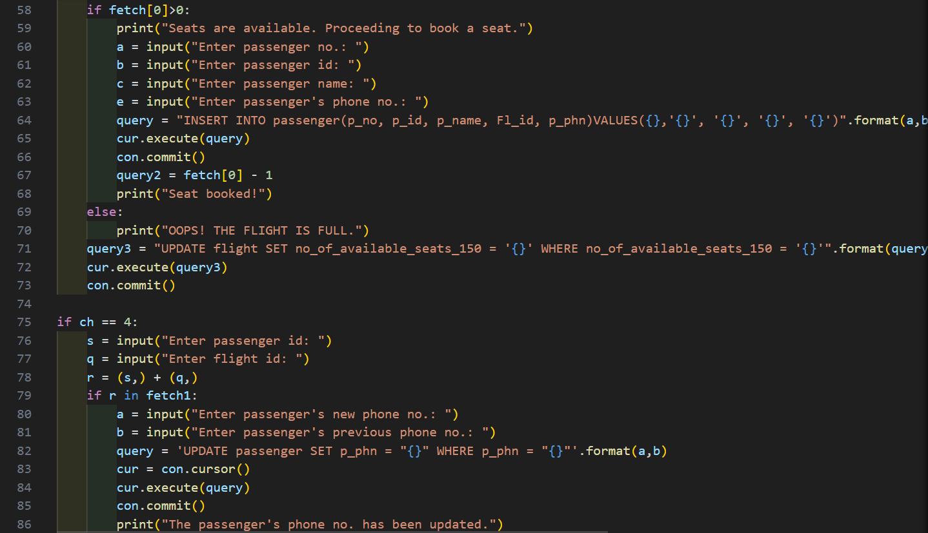

Slide 12
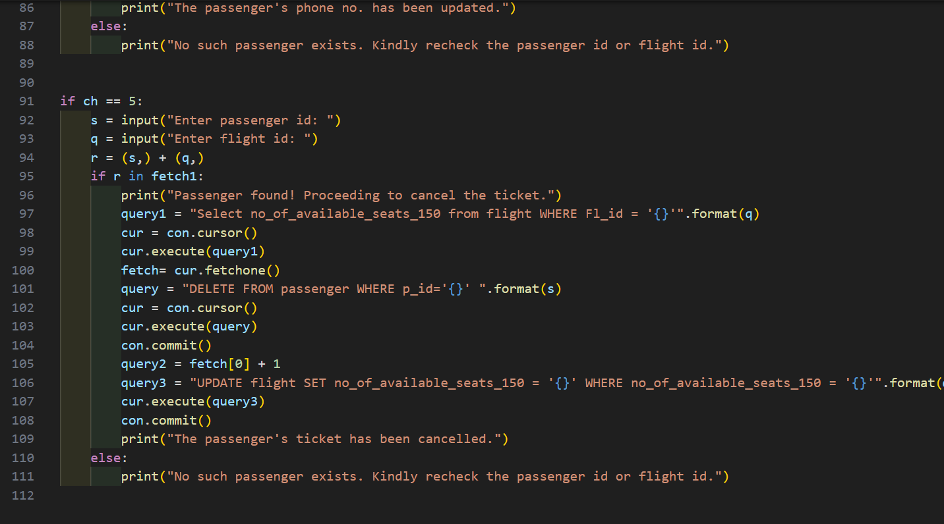

Slide 13
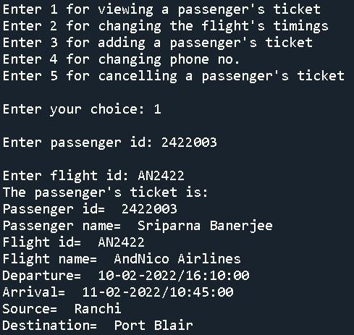
OUTPUTS:
Viewing a passenger’s ticket:

Slide 14
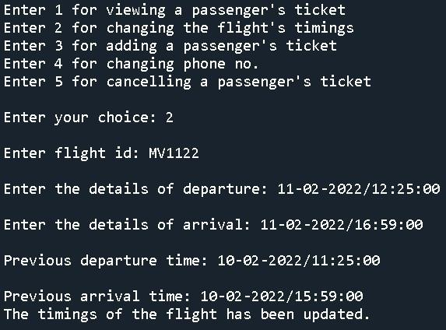
Changing the timings of the flight:

Slide 15
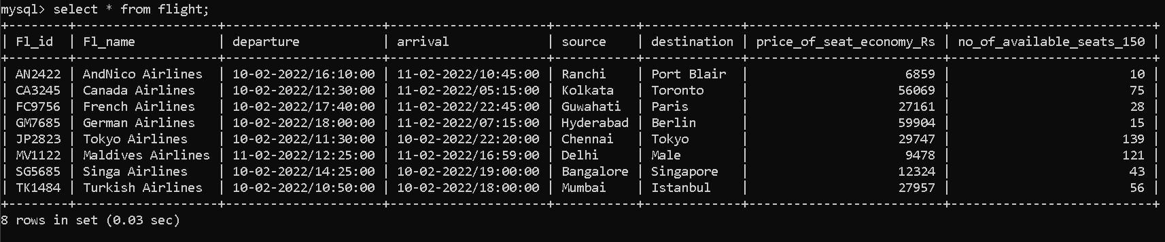
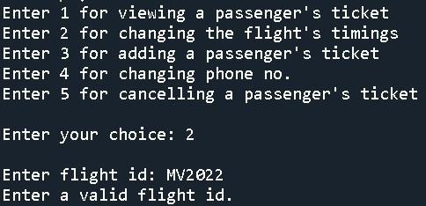

Slide 16
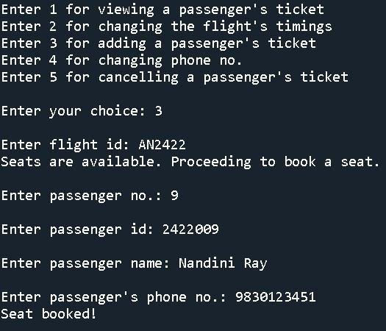
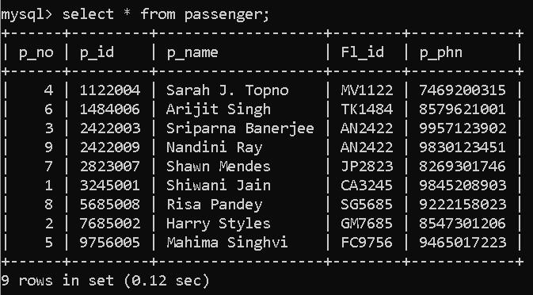
Adding a new passenger if the flight has vacant seats:

Slide 17
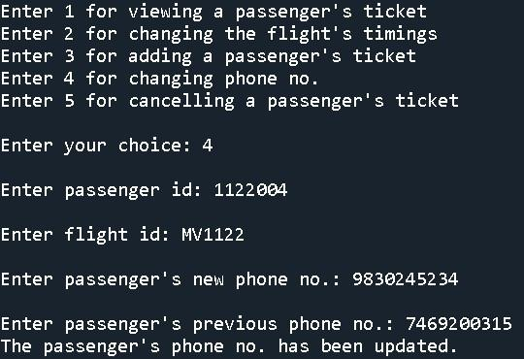
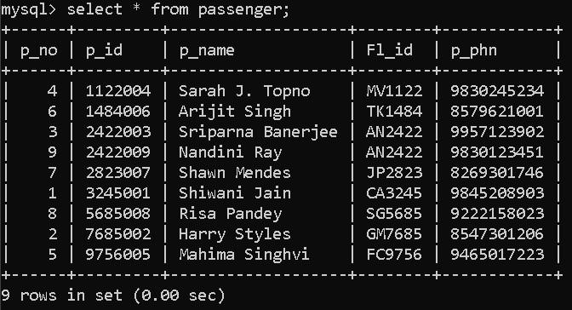
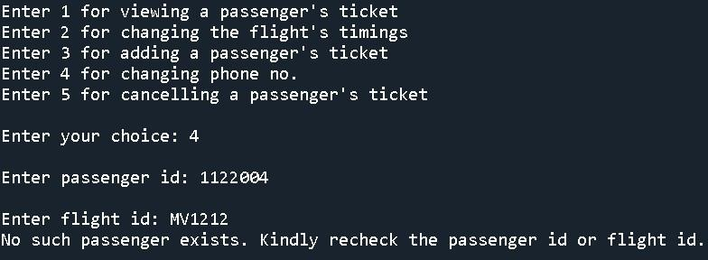
Changing the phone number of a passenger:

Slide 18
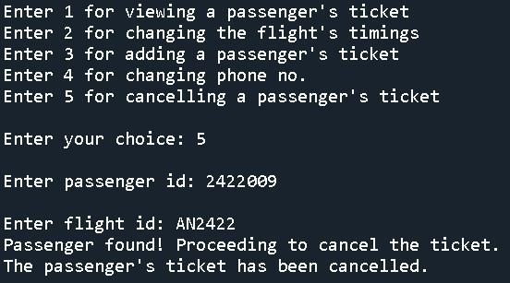
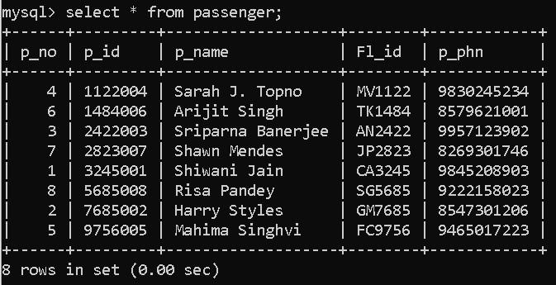
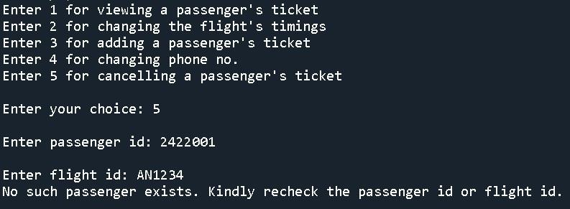
Cancelling a passenger’s ticket:

Slide 19
THANK YOU…

